Slide 1
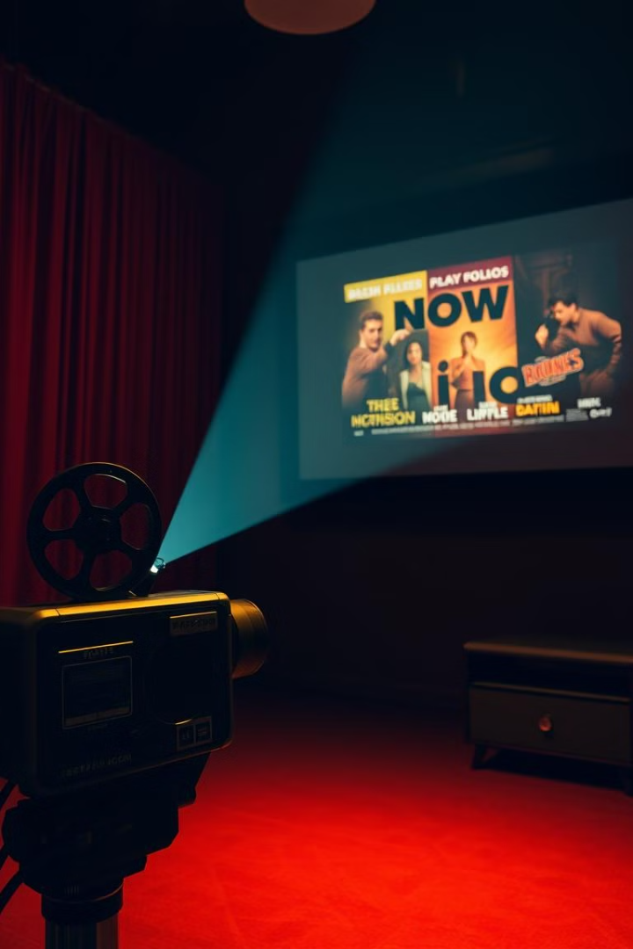
Building a Movie Recommendation System with Python
This presentation outlines the creation of a movie recommendation system similar to Netflix.
We will use Python, machine learning, and a Streamlit frontend.
The goal is to deliver dynamic, real-time movie suggestions to users.
Notes:
1

Slide 2
Recommendation System Overview
Collaborative Filtering
Content-Based Filtering
This approach recommends movies based on user similarities.
This method suggests movies similar to those a user liked in the past.
Users with similar viewing patterns receive similar suggestions.
Recommendations are based on movie attributes like genre and actors.
Notes:
2

Slide 3
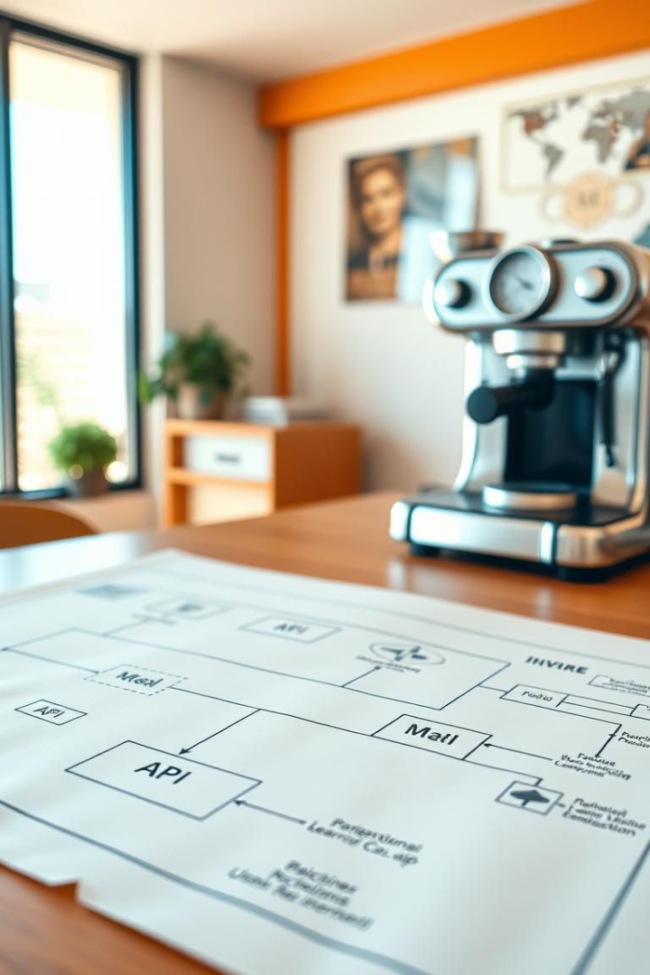



Project Architecture
API Data
Real-time movie data is fetched from external APIs.
This ensures recommendations are current.
ML Models (Pickle)
Machine learning models saved using pickle for efficient loading.
Allows for quick predictions.
Streamlit Frontend
Streamlit is used to create an interactive user interface.
Easy interaction for users.
Notes:
3

Slide 4
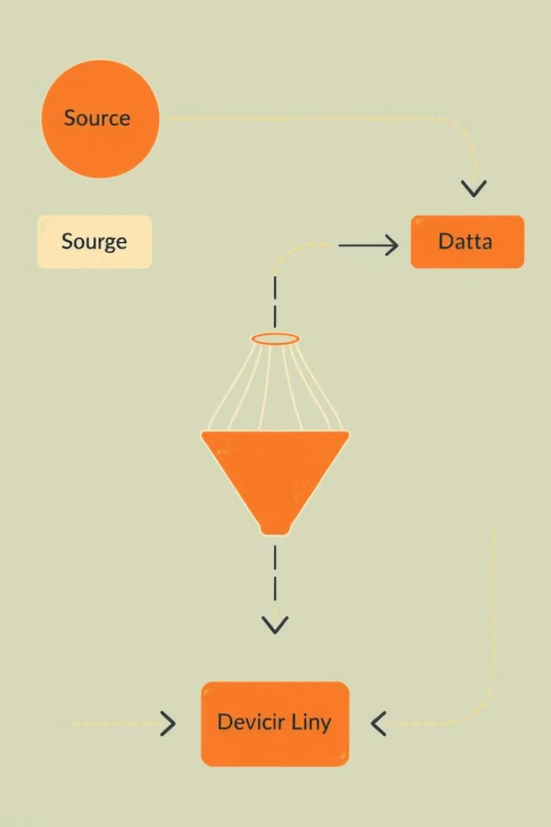
Implementation Steps
1
Data Fetching
2
Preprocessing
Obtain movie data from APIs like TMDb.
Clean and prepare the data for model training.
Collect relevant movie attributes.
Handle missing values and normalize data.
3
Model Training
Train machine learning models using the preprocessed data.
Select appropriate algorithms.
Notes:
4

Slide 5
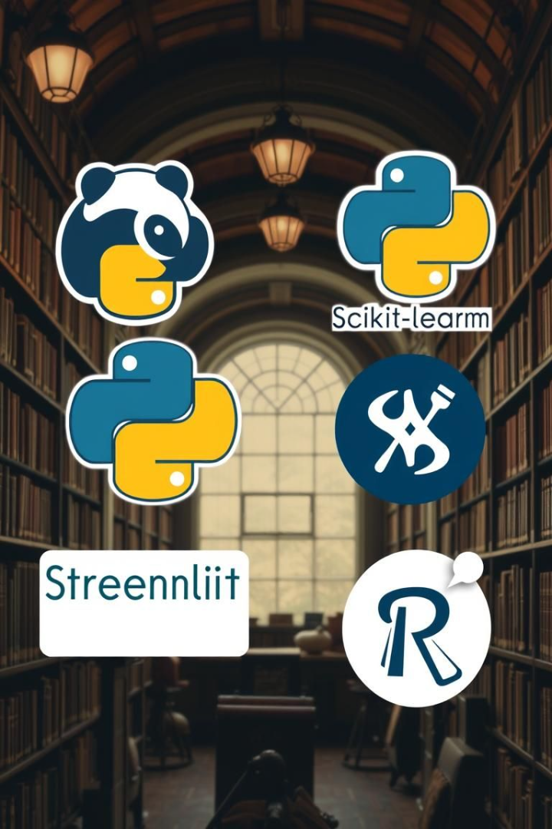




Key Python Libraries
Pandas
Scikit-learn
Streamlit
Used for data manipulation and analysis.
For machine learning model development.
To build the interactive web application.
Requests
For fetching data from APIs.
Notes:
5

Slide 6
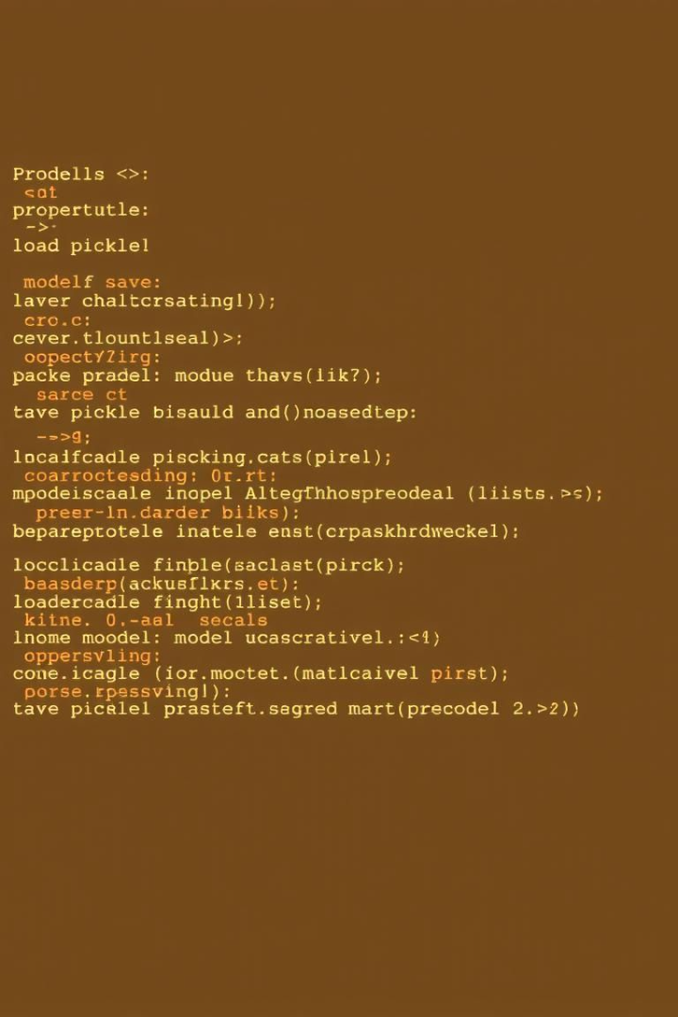
Model Saving and Loading
1
Pickling
Save trained models using Python's pickle library.
Ensures efficient loading of models.
2
Loading
Load saved models to make real-time predictions.
Fast and efficient.
3
Efficiency
Reduces training time by reusing pre-trained models.
Saves computational resources.
Notes:
6

Slide 7

Streamlit UI
Interactive Input
Dynamic Recommendations
User-Friendly
Users can input their movie preferences.
Display movie suggestions in real-time.
Simple and intuitive interface.
Notes:
7

Slide 8
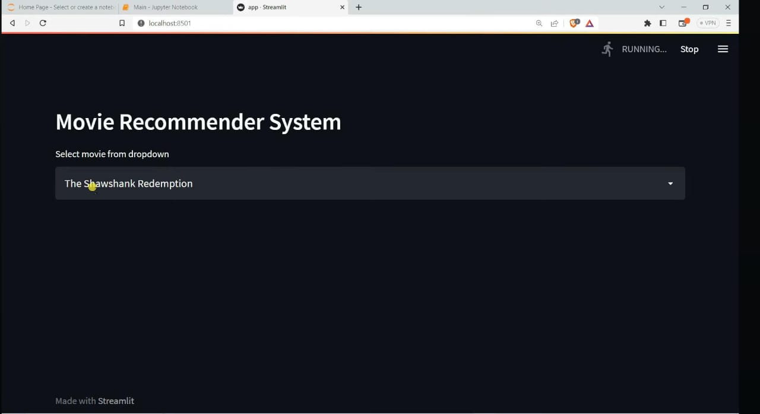

Slide 9
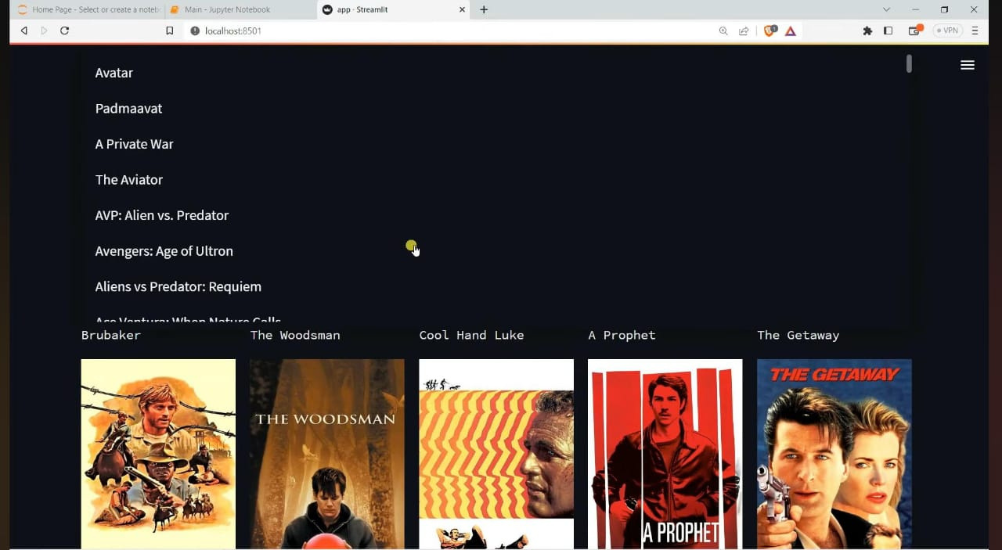

Slide 10
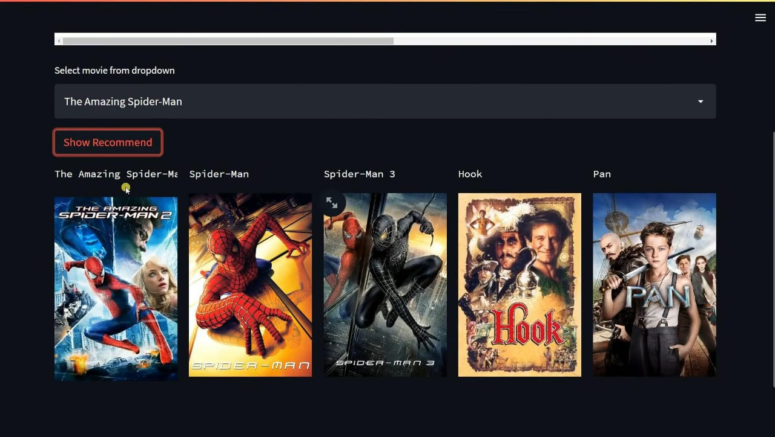

Slide 11
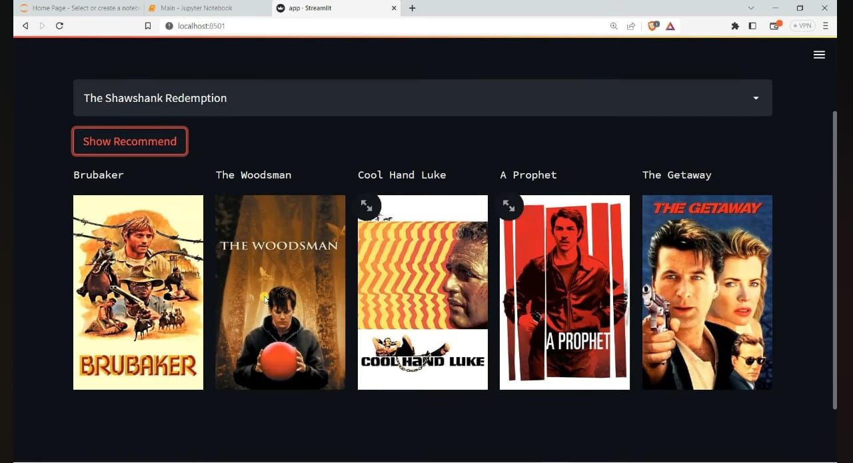

Slide 12



Demo and Future Enhancements
Future Steps
2
Improve model accuracy by incorporating user feedback.
System Demo
Showcasing the movie recommendation system in action.
1
3
Enhancements
Add more features such as genre selection.
Notes:
8

